Slide 1
Plant Disease Detection using Convolutional Neural Network

Slide 2



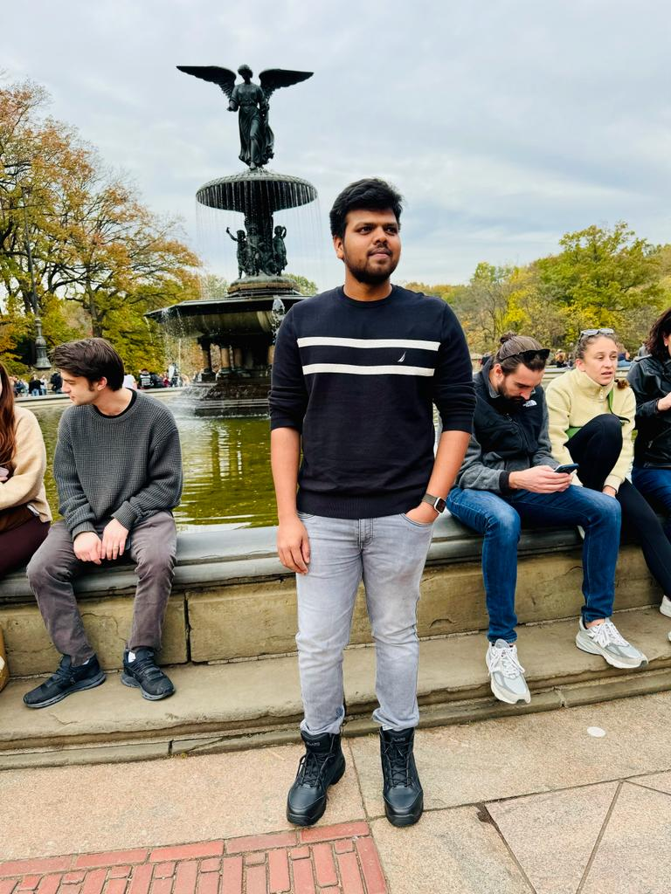
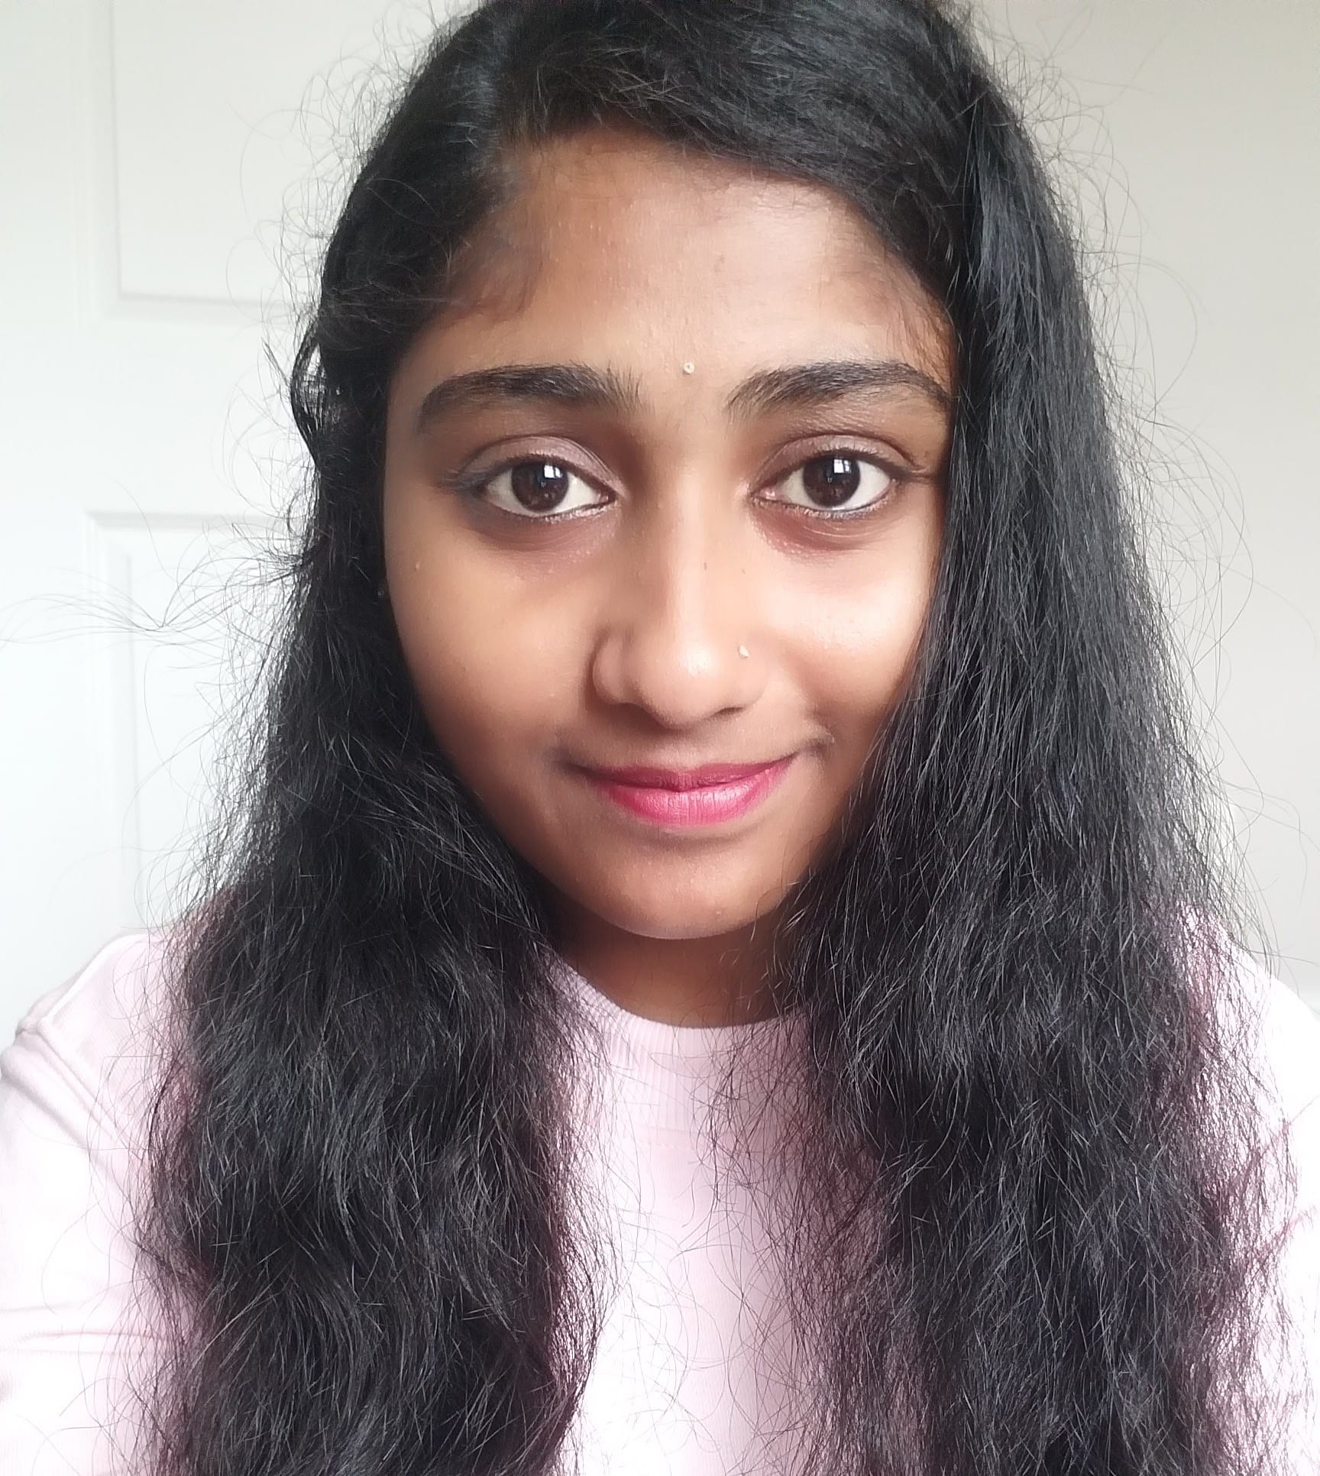
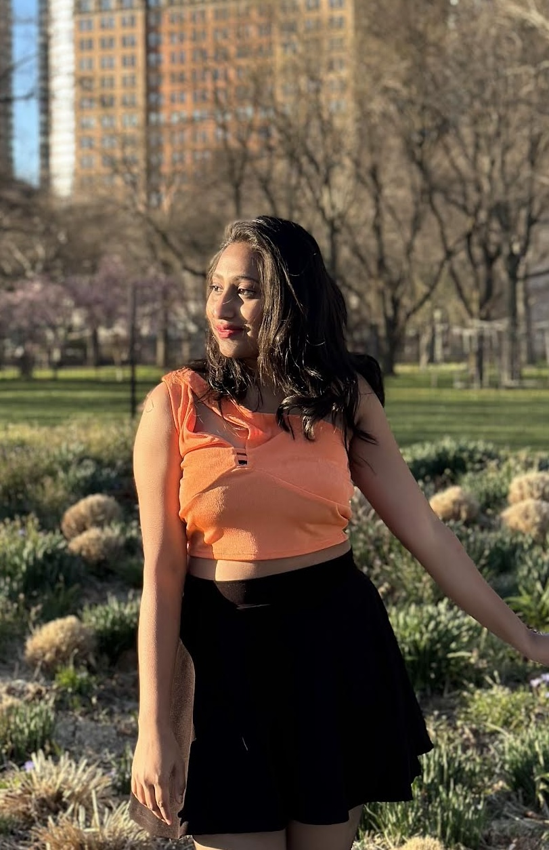
Team Members
Karhik Sura
Katikam Priyanka
Shiva Sai
Tejeshwar Reddy
Neelima Marepalli
Tulasi Sherla

Slide 3
Roles and Responsibilities
Karthik Sura (Developer)
Katikam Priyanka (Model Architect)
Tejeshwar Reddy (Developer)
Shiva Sai (Data Acquisition and Preprocessing Specialist)
Tulasi Sherla (Model Trainer and Validator)
Neelima Marepalli (Documentation and Presentation)

Slide 4
Introduction
PLANT DISEASE DETECTION USING CONVOLUTIONAL NEURAL NETWORK
Since the past days and in the present too, farmers usually detect the crop diseases with their naked eye which makes them take tough decisions on which fertilizers to use.
It requires detailed knowledge the types of diseases and lot of experience needed to make sure the actual disease detection.
Some of the diseases look almost similar to farmers often leaves them confused.

Slide 5
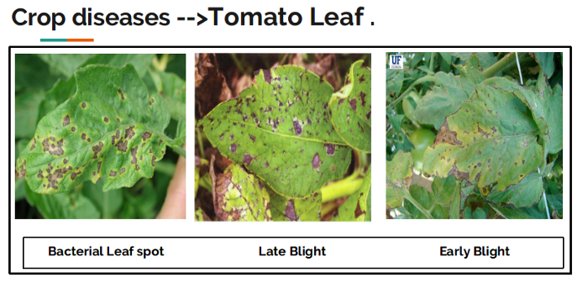
PLANT DISEASE DETECTION USING CONVOLUTIONAL NEURAL NETWORK
Look at the below image for more understanding.
They look the same and almost similar. In case the farmer makes wrong predictions and uses the wrong fertilizers or more than the normal dose (or) threshold or Limit (every plant has some threshold fertilizers spraying to be followed), it will mess up the whole plant (or) soil and cause enough damage to plant and fields.

Slide 6
So, How to prevent this from happening?
PLANT DISEASE DETECTION USING CONVOLUTIONAL NEURAL NETWORK
To prevent this situation we need better and perfect guidance on which fertilizers to use, to make the correct identification of diseases, and the ability to distinguish between two or more similar types of diseases in visuals.
This is where Convolution Neural Networks comes handy. In short CNN

Slide 7
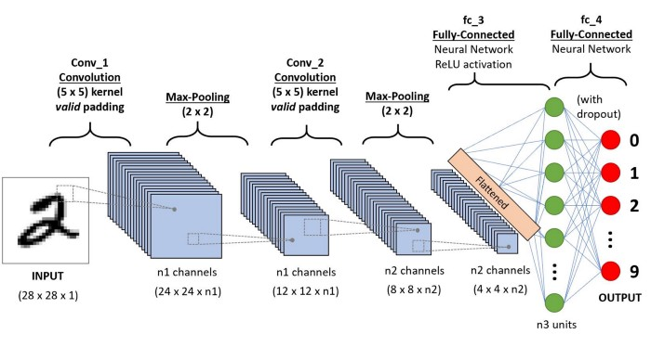
Convolution Neural Network
PLANT DISEASE DETECTION USING CONVOLUTIONAL NEURAL NETWORK
In deep learning, a convolutional neural network is a class of deep neural networks, most commonly applied to analyzing visual imagery. They are also known as shift invariant or space invariant artificial neural networks, based on their shared-weights architecture and translation invariance characteristics.

Slide 8
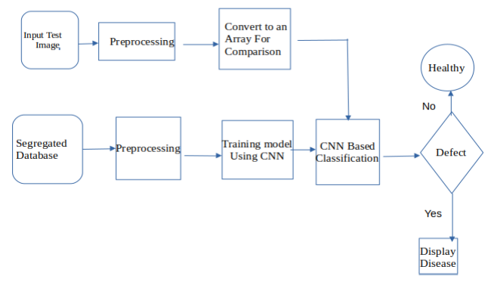
Proposed Methodology
PLANT DISEASE DETECTION USING CONVOLUTIONAL NEURAL NETWORK

Slide 9






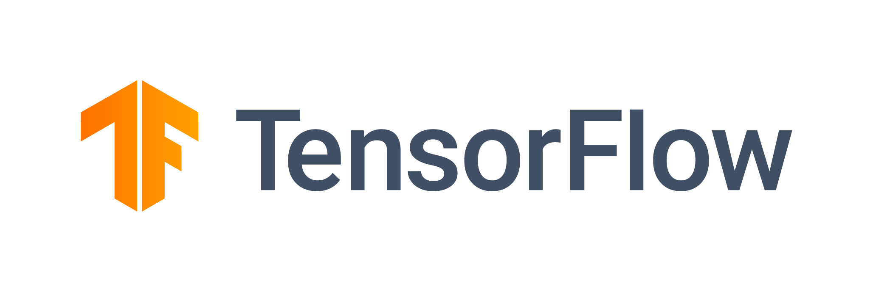
Tools Used
Colab
Keras
Matplotlib
Numpy
Opencv-python
6. Python
7. Tensorflow-gpu

Slide 10
Personas
PLANT DISEASE DETECTION USING CONVOLUTIONAL NEURAL NETWORK
1. The Farmer:
Name: Maria
Background: Maria is a small-scale farmer who grows crops such as tomatoes, potatoes, and peppers.
Needs: Maria wants to monitor her crops regularly for signs of disease to prevent crop loss and ensure a healthy harvest. She needs a user-friendly interface that allows her to easily upload images of her plants and receive quick and accurate diagnoses.
Motivation: Maria is motivated to increase her crop yield and profitability by identifying and treating plant diseases early.
2. The Agricultural Extension Officer:
Name: John
Background: John works as an agricultural extension officer in a rural area, providing advice and support to local farmers.
Needs: John needs a tool that can assist him in identifying plant diseases accurately during his visits to farms. He also requires access to educational resources and recommendations for disease management practices.
Motivation: John is motivated to help farmers improve their crop health and productivity, ultimately contributing to food security in the region.

Slide 11
personas
PLANT DISEASE DETECTION USING CONVOLUTIONAL NEURAL NETWORK
3. The Researcher:
Name: Dr. Patel
Background: Dr. Patel is a plant pathologist conducting research on crop diseases.
Needs: Dr. Patel requires a platform that can analyze large datasets of plant images to identify trends in disease prevalence and monitor the spread of new pathogens. Access to advanced analytics tools and the ability to collaborate with other researchers are also important.
Motivation: Dr. Patel is motivated to advance scientific knowledge about plant diseases and develop effective strategies for disease management and control.
4. The Agri-Tech Entrepreneur:
Name: Sarah
Background: Sarah is an entrepreneur who runs a startup company focused on developing agricultural technology solutions.
Needs: Sarah needs a plant disease detection system that can be integrated into mobile applications or IoT devices for widespread adoption by farmers. She also requires access to APIs or SDKs to customize the system and integrate it with other agricultural technologies.
Motivation: Sarah is motivated to create innovative solutions that address real-world challenges in agriculture while building a successful business.

Slide 12
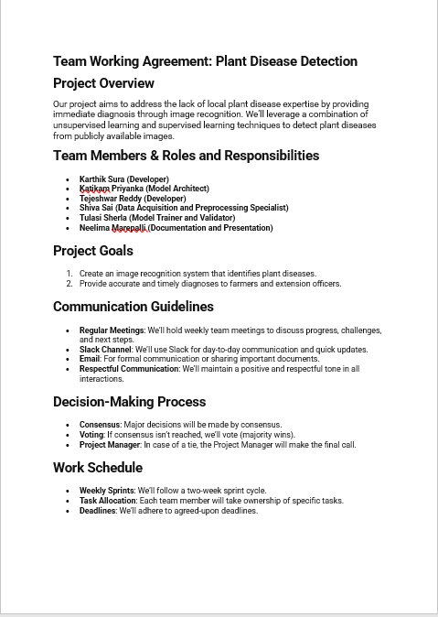
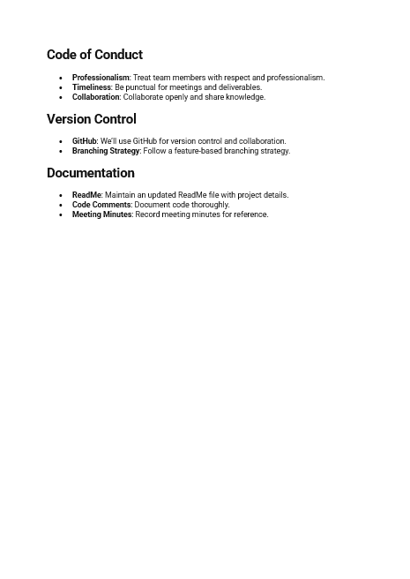
Working Agreement
PLANT DISEASE DETECTION USING CONVOLUTIONAL NEURAL NETWORK

Slide 13
Retrospective
PLANT DISEASE DETECTION USING CONVOLUTIONAL NEURAL NETWORK
What went well?
▪ We as a team have planned to keep our objective simple to finish and produce what was expected.
▪ Team had good time working together.
▪ Active response from team to get involved in tasks with clear thoughts.
▪ The key was participation and motivation to complete task in time and every member knew what they had to do.
▪ We had several discussion sessions.
▪ Overall, every meeting session is effectively used to gain progress and complete sprint on time.

Slide 14
PLANT DISEASE DETECTION USING CONVOLUTIONAL NEURAL NETWORK
What Could Be Improved?
We frequently try to communicate to discuss about project and advancements even after the sprintcompletion.
Setting up time limit for the tasks and learning from previous semester student’s sprintsperformance to make improvements and where can we be better.
What we plan to commit for next sprint?
Maintain consistency in performance, improvement is key.
Previous students sprint retro can be helpful for improving team balance in which areas team islacking, where we can work according to that.
Previous retro stats can be helpful in filling the gaps of next sprint

Slide 15
WIKI Page
PLANT DISEASE DETECTION USING CONVOLUTIONAL NEURAL NETWORK
https://github.com/surakarthi/Group-2-Cs-691/wiki/Welcome-to-the-Group%E2%80%902%E2%80%90Cs%E2%80%90691-wiki!

Slide 16
Thank You
PLANT DISEASE DETECTION USING CONVOLUTIONAL NEURAL NETWORK

